Slide 1
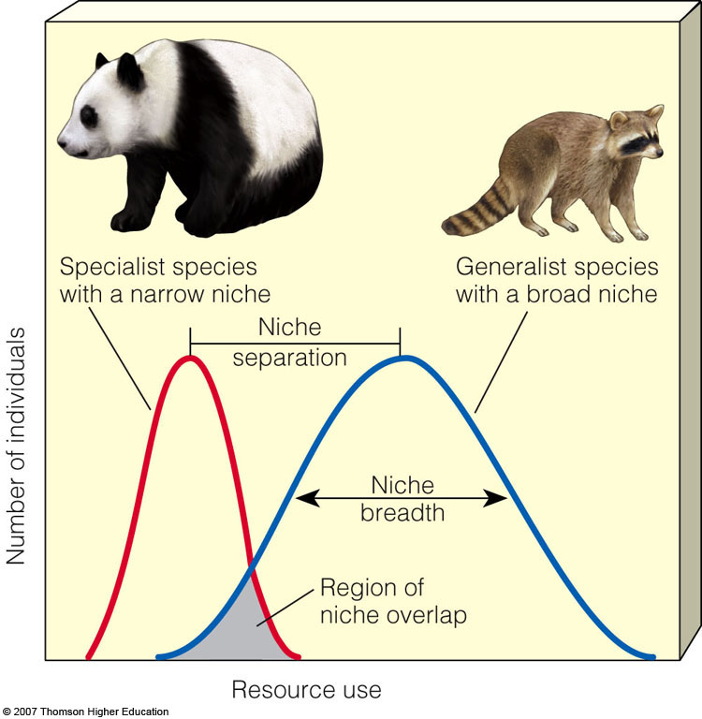
Generalist and Specialist Species:
Broad and Narrow Niches
Generalist species tolerate a wide range of conditions.
Specialist species can only tolerate a narrow range of conditions.

Slide 2
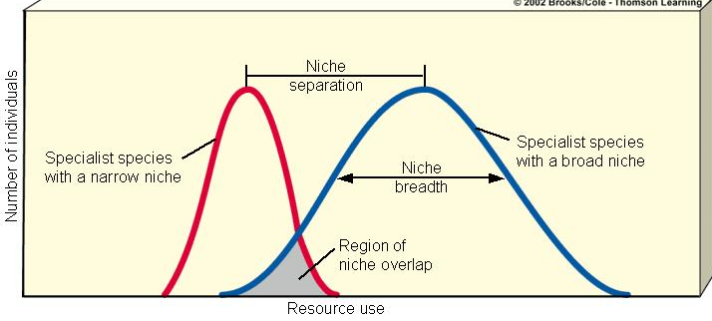
Is it better to be a Generalist or a Specialist?
Answer: It depends.

Slide 3
Speciation, Extinction, and Biodiversity
Speciation - formation of two species from one species because of divergent natural selection
    Geographic isolation – groups of the same species become physically separated

Slide 4
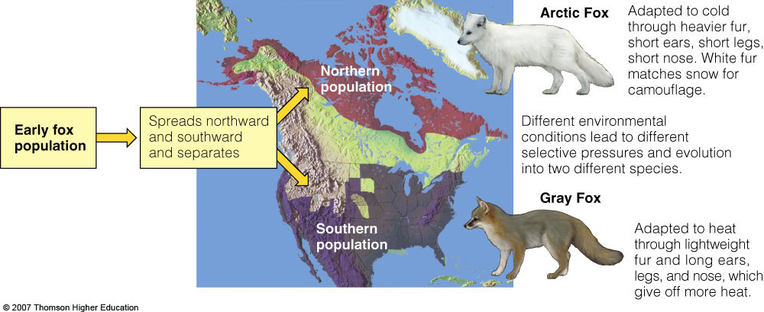
Geographic Isolation
…can lead to reproductive isolation, divergence of gene pools and speciation.

Slide 5
Speciation, Extinction, and Biodiversity
  Reproductive Isolation – isolated populations become so genetically different they cannot . . .
        Interbreed, or
        produce live, fertile offspring

Slide 6
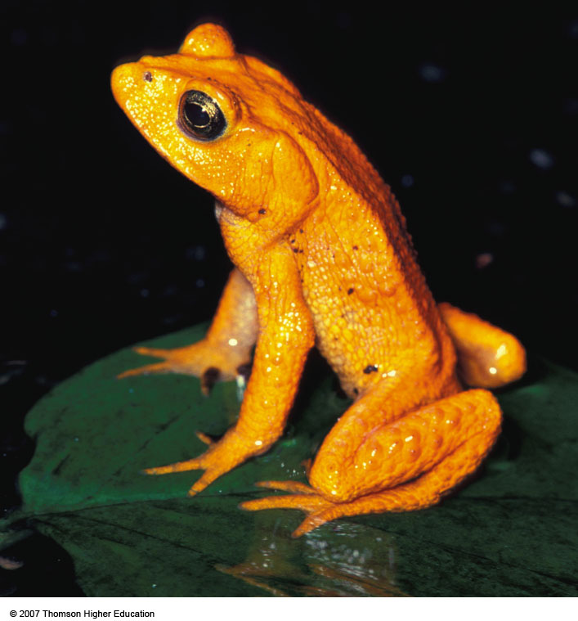
Extinction: Lights Out
Extinction occurs when the population cannot adapt to changing environmental conditions.
The golden toad of Costa Rica’s Monteverde cloud forest has become extinct because of changes in climate.

Slide 7
Extinction: Lights Out
99.9 % of all species that ever existed are now extinct

Slide 8
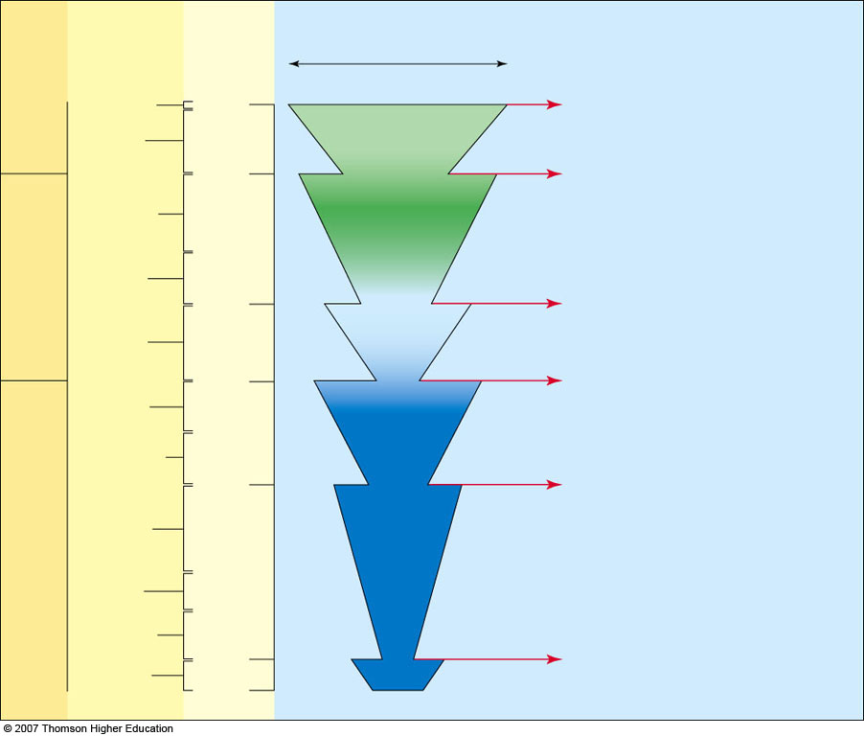
Bar width represents relative
number of living species
Species and families
experiencing
mass extinction
Era
Period
Millions of
years ago
Quaternary
Today
Extinction
Current extinction crisis caused
by human activities. Many species
are expected to become extinct
within the next 50–100 years.
Cenozoic
Tertiary
Extinction
65
Cretaceous: up to 80% of ruling
reptiles (dinosaurs); many marine
species including many
foraminiferans and mollusks.
Cretaceous
Mesozoic
Jurassic
Extinction
Triassic: 35% of animal families, including many reptiles and marine mollusks.
180
Triassic
250
Extinction
Permian: 90% of animal families, including over 95% of marine species; many trees, amphibians, most bryozoans and brachiopods, all trilobites.
Permian
Carboniferous
345
Extinction
Devonian: 30% of animal families, including agnathan and placoderm fishes and many trilobites.
Paleozoic
Devonian
Silurian
Ordovician
Extinction
500
Ordovician: 50% of animal families, including many trilobites.
Cambrian
Notes:
Figure 4.12
Fossils and radioactive dating indicate that five major mass extinctions (indicated by arrows) have taken place over the past 500 million years. Mass extinctions leave many organism roles (niches) unoccupied and create new niches. Each mass extinction has been followed by periods of recovery (represented by the wedge shapes) called adaptive radiations. During these periods, which last 10 million years or longer, new species evolve to fill new or vacated niches. Many scientists say that we are now in the midst of a sixth mass extinction, caused primarily by human activities.

Slide 9
Extinction
Background extinction
  Normal extinction of various species as a result of changes in local environmental conditions
Mass extinction
  extinction resulting from catastrophic, wide-spread event in which large groups of existing species are wiped out
Adaptive radiation
  Process in which numerous new species evolve to fill vacant and new ecological niches in changed environments

Slide 10
Period of Recovery Following Extinction
Adaptive radiation -
  Process in which numerous new species evolve to fill vacant and new ecological niches in changed environments

Slide 11
How do speciation and extinction affect biodiversity?
Speciation – Extinction = Biodiversity
Extinctions and depletions temporarily reduce biodiversity YET create evolutionary opportunities for surviving species to undergo adaptive radiations to fill unoccupied and new biological niches

Slide 12
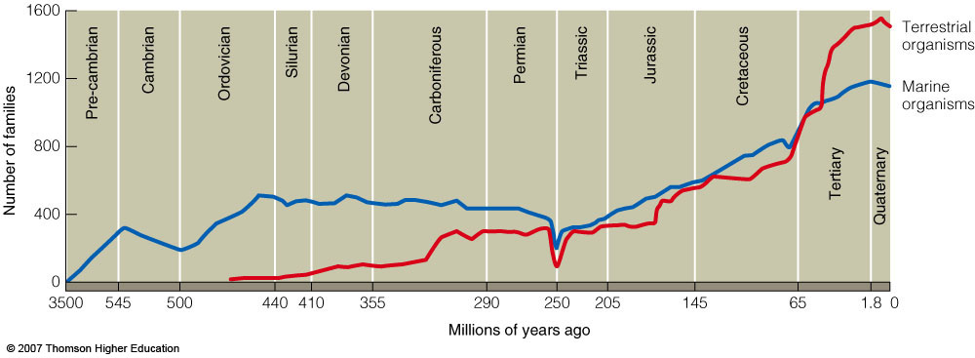
Effects of Humans on Biodiversity
The scientific consensus is that human activities are decreasing the earth’s biodiversity.

Slide 13
